Slide 1

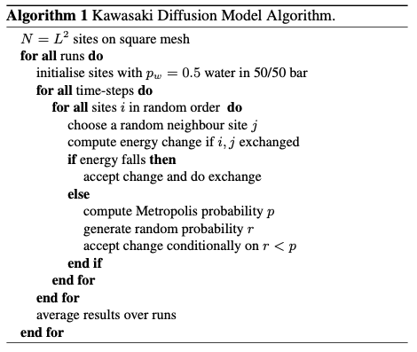
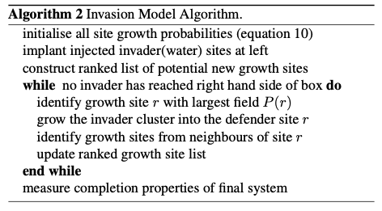
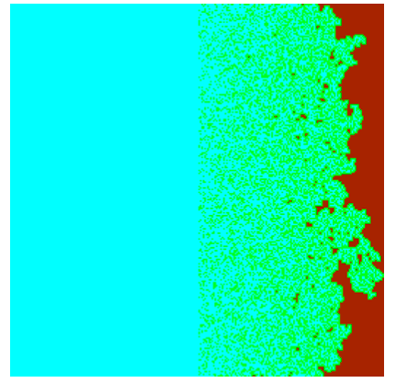
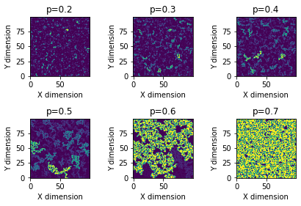
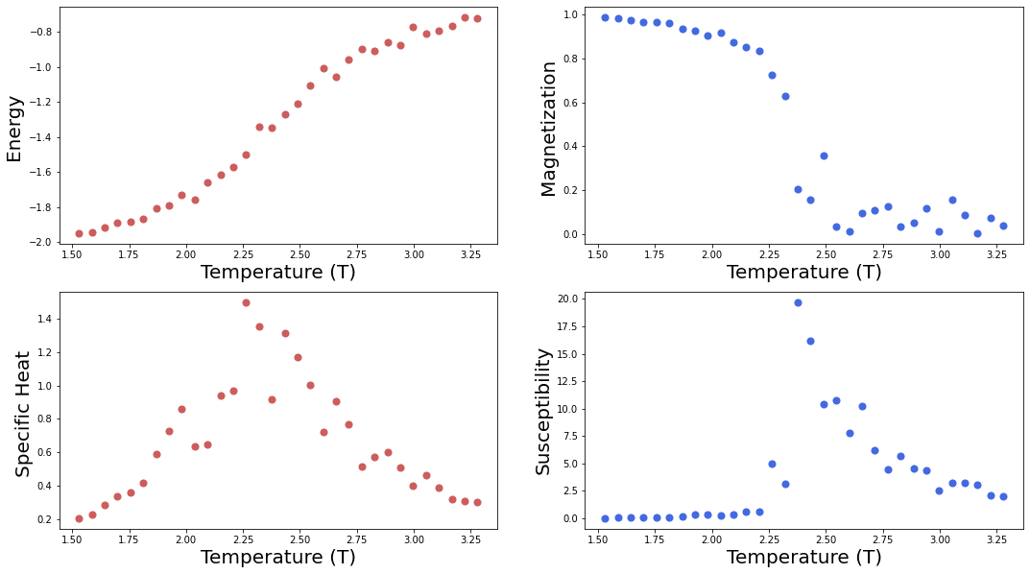
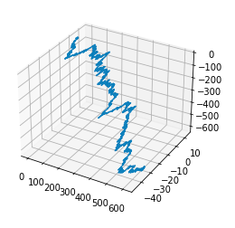
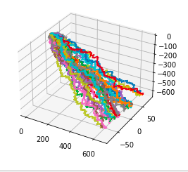
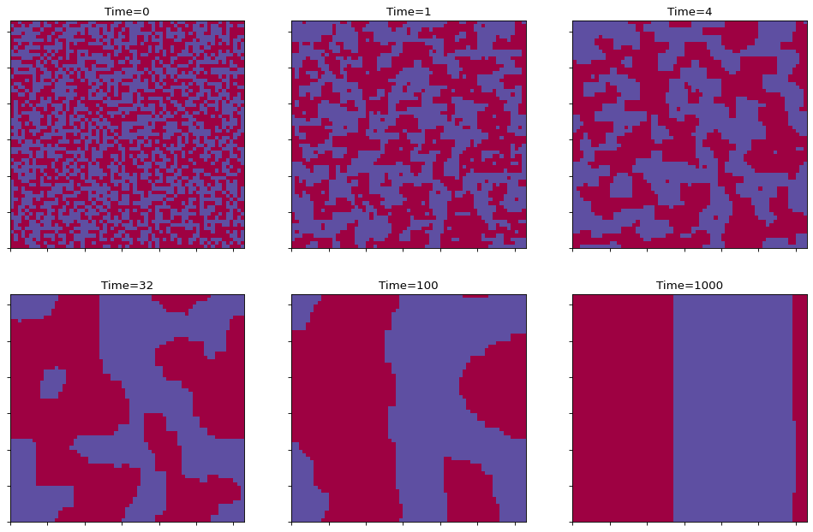
Utilizing Cellular Automata to Model
Random Paths of Coastal Erosion
Clarissa Skipworth¹, Dr. Richard Olenick, Ph.D.¹
¹Department of Physics, University of Dallas, Irving, TX USA
Abstract
Procedure and Results
Results
The randomized process of increased coastal erosion and its runoff caused by flooding due to increasing sea level can be modeled by a hybrid of cellular automata simulations. Such cellular automata simulations include the Kawasaki site exchange automaton and the Invasion Percolation model. In this project report, we approach this concept first with an elementary Pythonic implementation of 3D walks, and then run, analyze, and discuss these more complex cellular automata models.
Background
Figure 6. An outline of the Invasion Percolation Model Algorithm
Accurate simulation of coastal erosion is especially useful to environmental scientists, whose research has been indicating for years that "already-severe coastal erosion problems witnessed in the 20th century will be exacerbated in the 21st century under plausible
global warming scenarios.”⁵ Since both
the Kawasaki site exchange automaton
and the Invasion Percolation models
require an ambitious amount of code,
we focus on the Kawasaki automaton
and briefly showcase an Invasion
Percolation model. Combining these
two models results in a more accurate
simulation that can hopefully give both
environmental and computer
scientists better insight into the
process’ natural randomness.
We finish our investigation with a model of the Invasion Percolation process as applied across different percolation constant values. Combined with the Kawasaki model on a 50/50 bar configuration, in which "an injected wetting fluid that invades the space occupied by a non-wetting defender fluid"³, we can approach a model of randomized coastal erosion.
Figure 3. The Algorithm for the Kawasaki Diffusion Model, which entails the Metropolis algorithm run in iterations over each site on a square mesh lattice.
We investigate a simulation of the Kawasaki Site Exchange Model, by first simulating its foundation, the Ising model, through the Monte Carlo method and Metropolis algorithm (Singh, 2020), and then reviewing its application in site exchange (Kawasaki, 1966). The Ising model is key to the theory of phase transitions, and mathematically models ferromagnetism (Singh, 2020).
Figure 1. Hawick’s simulation result: Step 15,502 of an invasive model variant where cyan sea has eroded brown land-mass.³
Procedure
Par here
Figure 7. Configuration phases captured in snapshots across increasing time, simulating a random initial state coarsening down to its equilibrium state.
Figure 4. Plotted ferromagnetism results from the Ising model.
Discussion and Conclusions
Now we use this plotted data in the Monte Carlo method on the Ising model to produce snapshots of diffusion configurations over time.
This hybrid program is cost-effective and its results are moderately accurate, at least as far as randomized data can be. Future research could entail animating the hybrid model in 3D as it traverses across time steps. This kind of simulation would not only provide scientists with more insight into coastal erosion, but provide the average observer with a lasting impression of the effects of erosion not typically seen over long stretches of time.
Figure 2. A plot of a singular directionally-restricted 3D random walk next to a plot of 30 simultaneous directionally-restricted 3D random walks, to simulate the path a particle takes or a flow of independent particles take in downhill erosion.
References
Our research begins with a 3D random walk model with both a singularly seeded instance and 30 simultaneously seeded instances. Of course, although this simulation presents various random paths down a hillside-like decline, they do not rest upon a predetermined lattice or grid of the landscape, and each path's route runs independently from the others. We thus proceed to the Kawasaki Site Exchange Model for a more realistic simulation that will take into account convergence and diffusion of liquid paths across one terrain.
Dearing, John, A. J. Plater, and N. C. Richmond. "Towards a high resolution cellular model for coastal simulation (CEMCOS)." AGU Fall Meeting Abstracts. Vol. 2004. 2004.
Hawick, K. A. An agent model formulation of the ising model. Tech. rep., Information and Mathematical Sciences, Massey University, Albany, North Shore 102-904, Auckland, New Zealand (November 2003), 2003.
Hawick, Ken A. "Modelling flood incursion and coastal erosion using cellular automata simulations." ASTED International Conference on Environmental Management and Engineering. 2014.
Singh, Rajesh. “Ising Model: a Mathematical Model for Phase Transitions.” Blog, 22 Feb. 2020, https://rajeshrinet.github.io/blog/2014/ising-model/.
Zhang, Keqi, Bruce C. Douglas, and Stephen P. Leatherman. "Global warming and coastal erosion." Climatic change 64.1 (2004): 41-58.
Figure 5. Configuration phases captured in snapshots across increasing time, simulating a random initial state coarsening down to its equilibrium state.

